Slide 1

Next Generation NCLEX: Countdown to Launch
Jason A. Schwartz, MS
Director of Outreach, NCSBN

Slide 2
Copyright © 2022 National Council of State Boards of Nursing, Inc. (NCSBN®)
All rights reserved. NCLEX®, NCLEX-RN® and NCLEX-PN® are registered trademarks of NCSBN® and may not be used or reproduced without written permission from NCSBN. No part of the these materials may be reproduced, stored in a retrieval system or transmitted in any form by any means (electronic, mechanical, photocopying, recording, or otherwise now known or to be invented) for any commercial or for profit use or purpose without written permission from NCSBN. Inquiries in writing to NCSBN Permissions, 111 E. Wacker Drive, Suite 2900, Chicago, IL 60601-4277 or via email at communications@ncsbn.org.

Slide 3
Overview
Next Generation NCLEX timeline
Why is the NCLEX changing?
How is the NCLEX changing?
NCSBN Resources
Audience Q & A

Slide 4


Slide 5
NGN Timeline

Slide 6
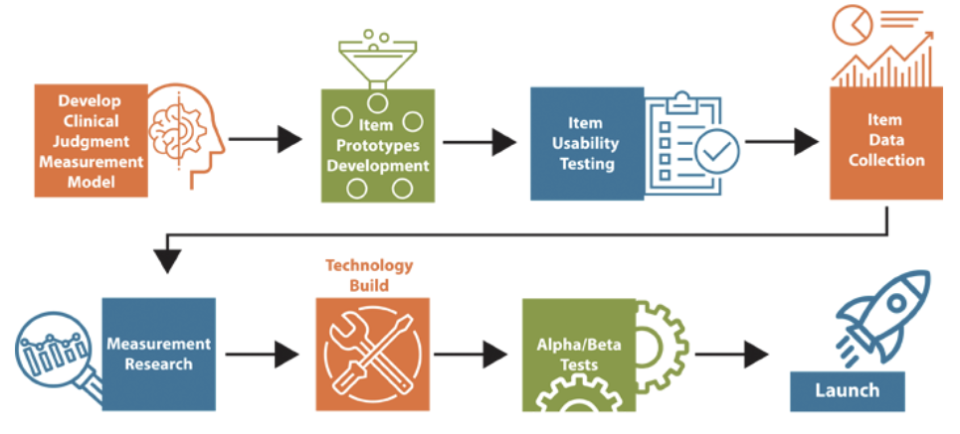
NGN Pre-Launch Checklist
2012
2023

Slide 7
Foundations

Slide 8

NGN origin story
2012 NCLEX Examination Committee--
“Is the NCLEX measuring the right things?”
Literature review
Strategic Practice Analysis

Slide 9

Literature Review Findings
    Education regarding critical thinking, clinical decision making, and clinical judgment has already become a standard part of nursing curricula
    Clinical judgment, even at the entry-level, is critical to patient safety and public protection
20%
employers satisfied with clinical decision making skills of novice nurses
50%
novice nurses involved in nursing errors
65%
errors attributed to poor clinical decision making

Slide 10
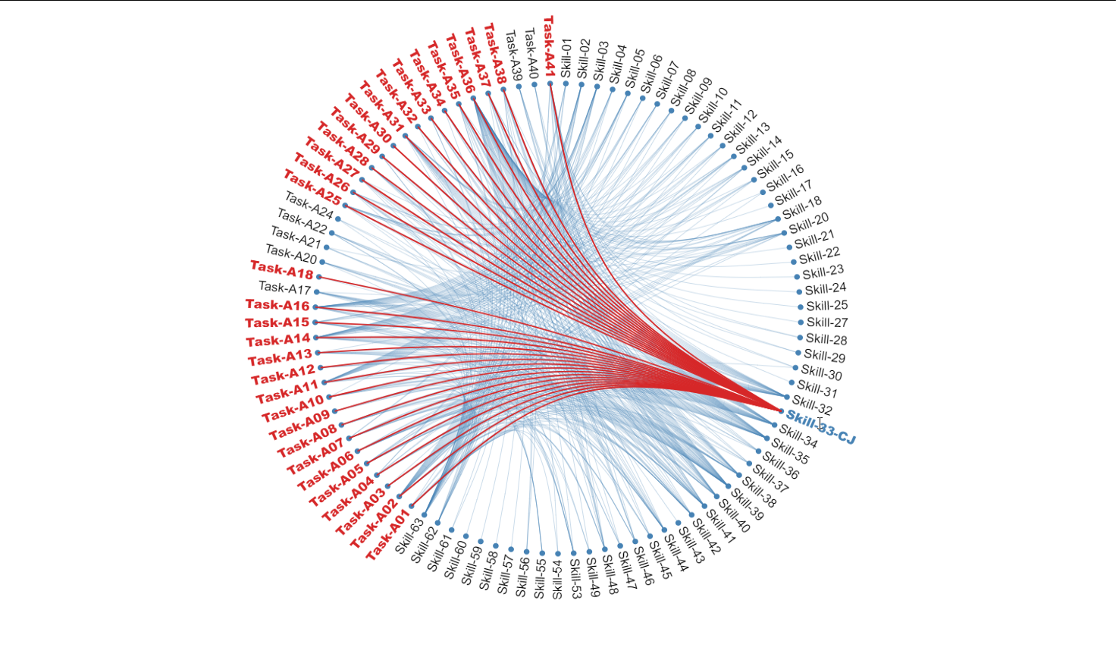
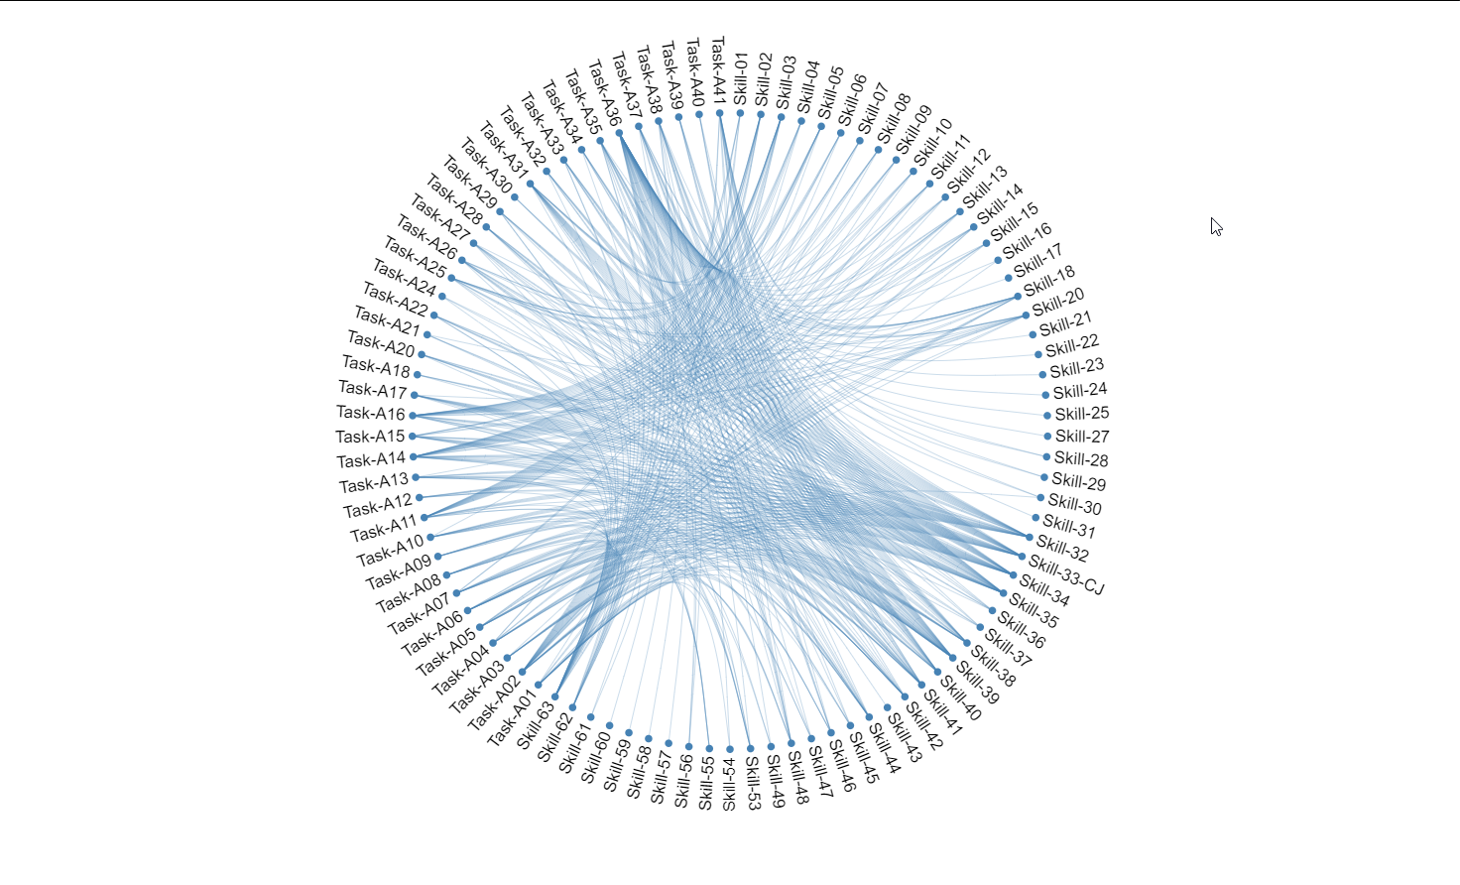
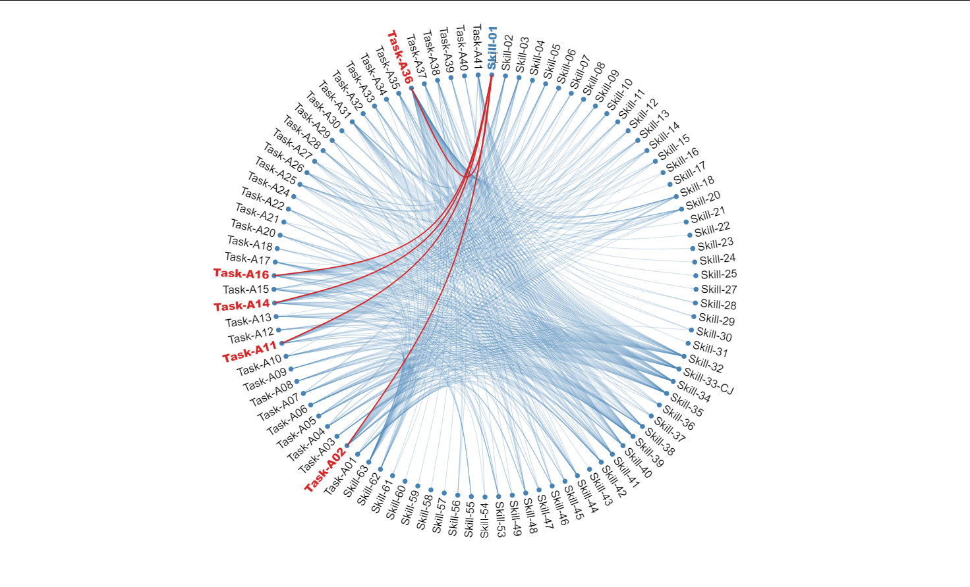
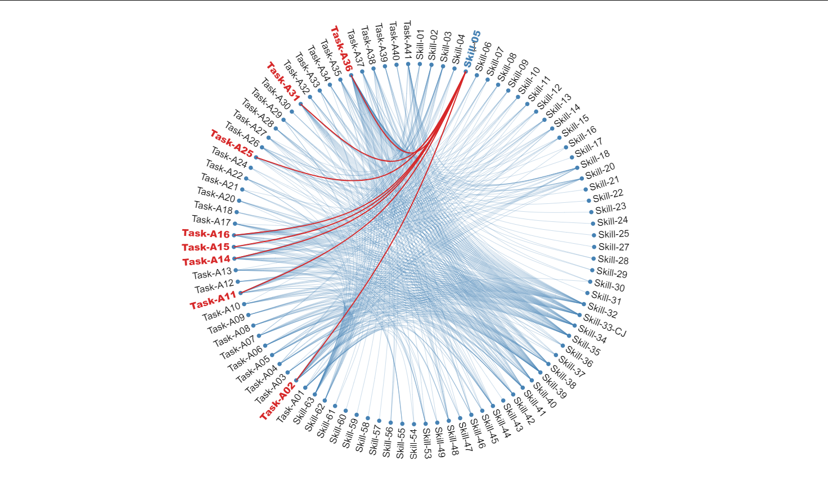
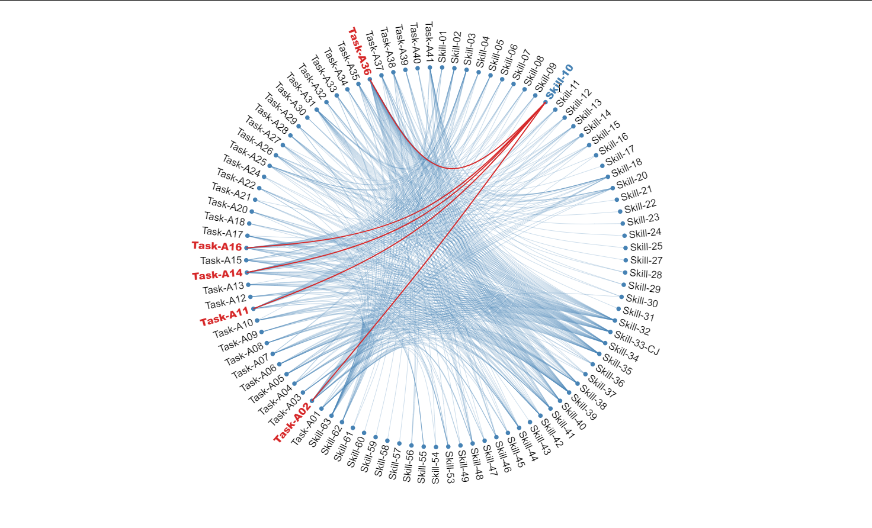
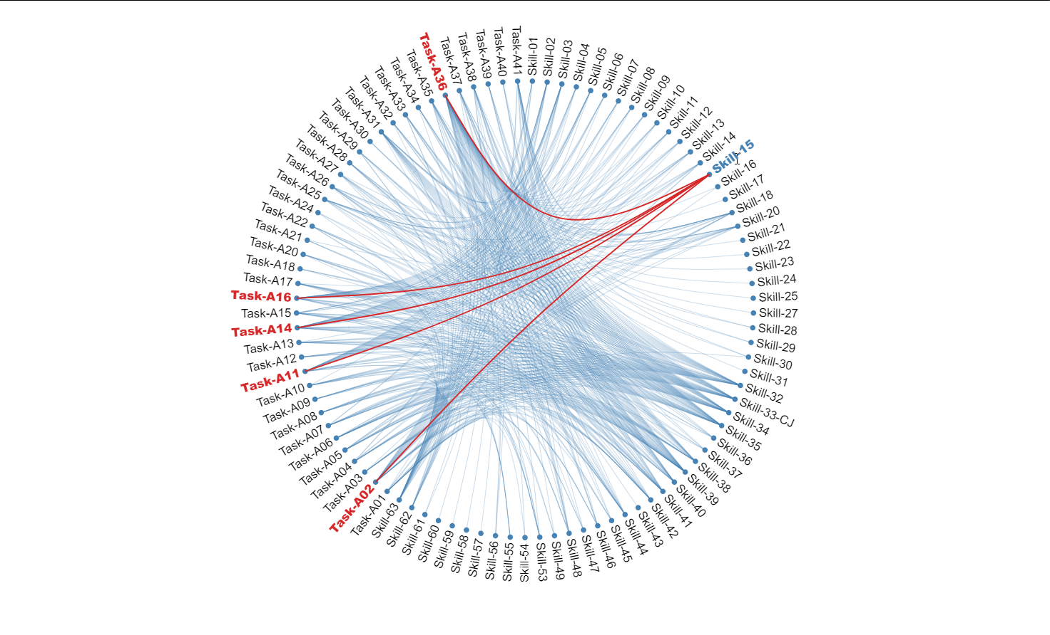
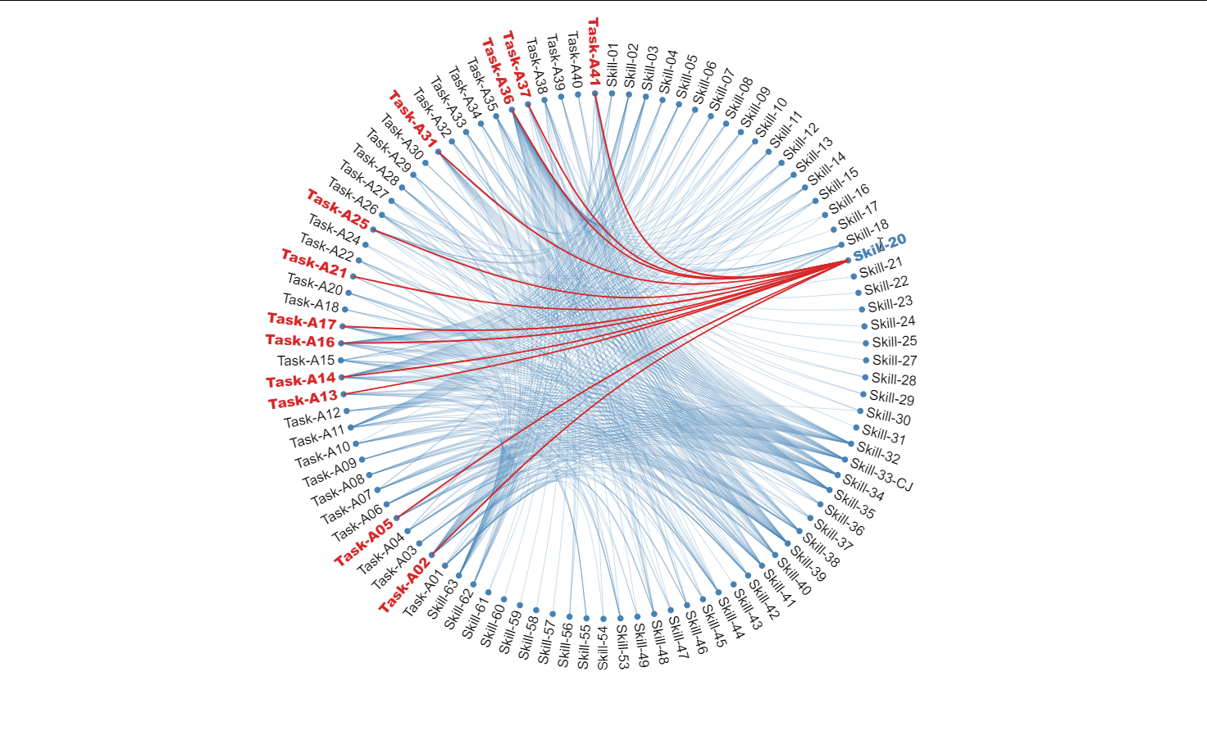
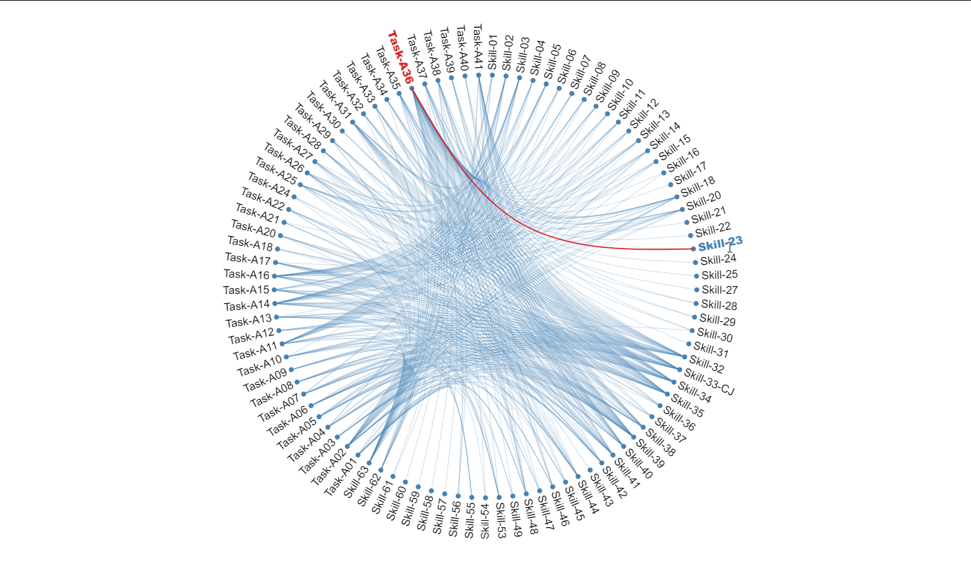

Slide 11
Conclusions
Clinical judgment is an important and necessary skill, even at the entry-level
Providing a more direct, evidence-based measure of clinical judgment
requires both additional research and the use of new item types
The current NCLEX addresses clinical judgment indirectly but is limited
by the item types available
1
2
3

Slide 12

Measuring Clinical Judgment

Slide 13
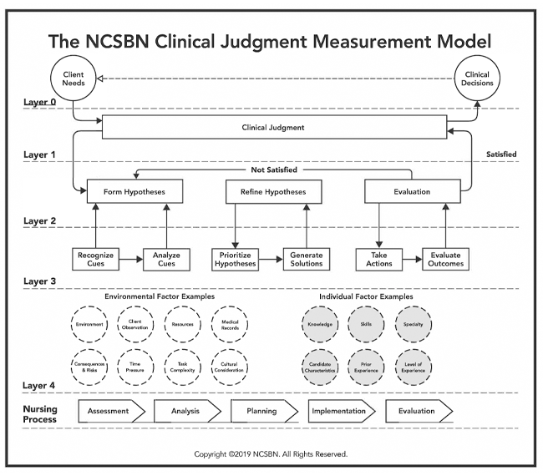


Slide 14
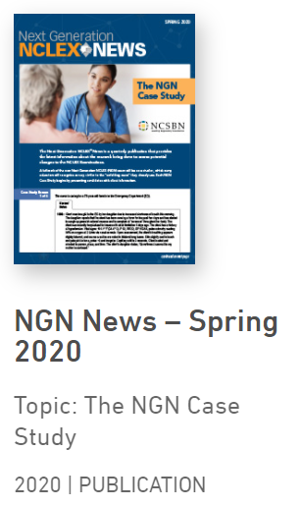
NGN Case Study

Slide 15
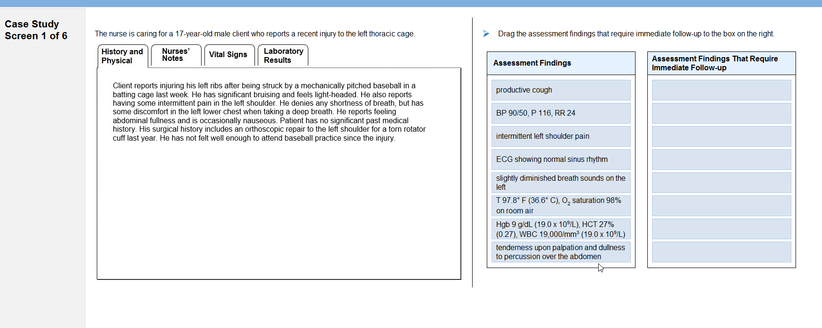
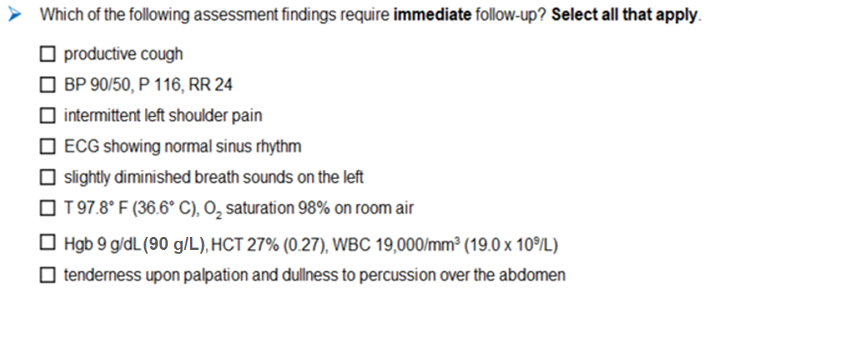
Sample Case Study
2
7
1
3
4
5
6

Slide 16
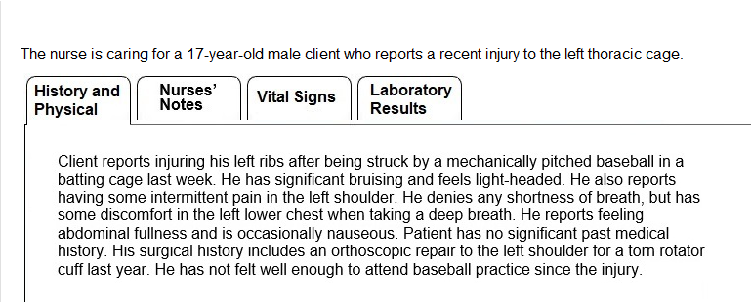
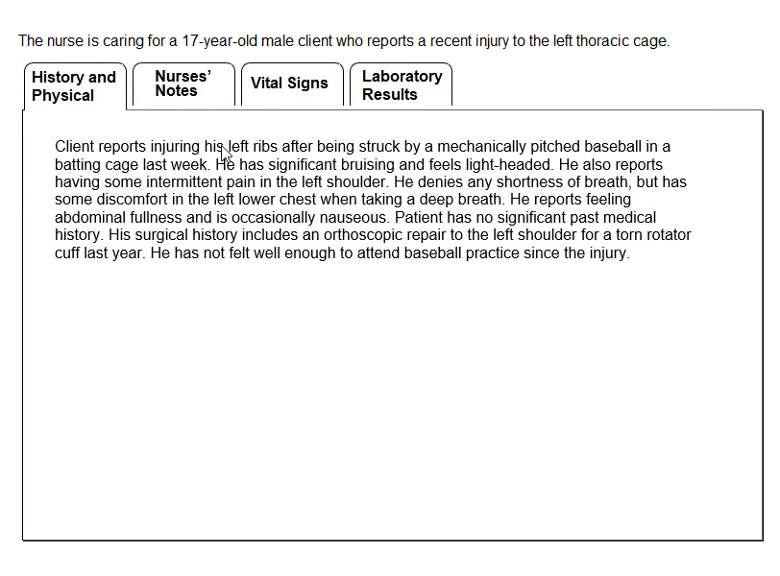

Slide 17
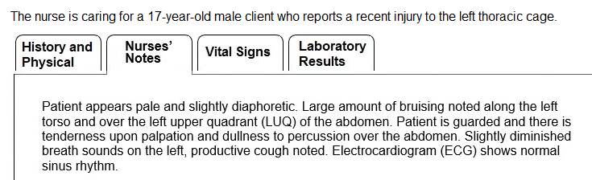
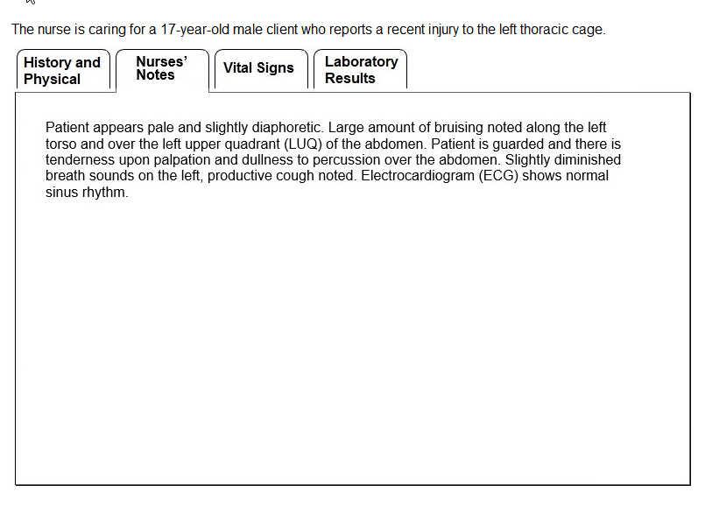

Slide 18
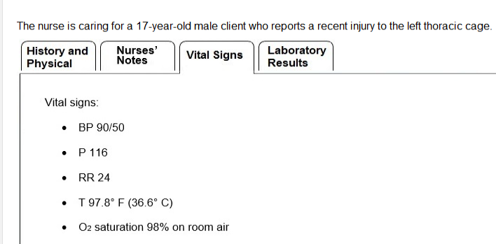
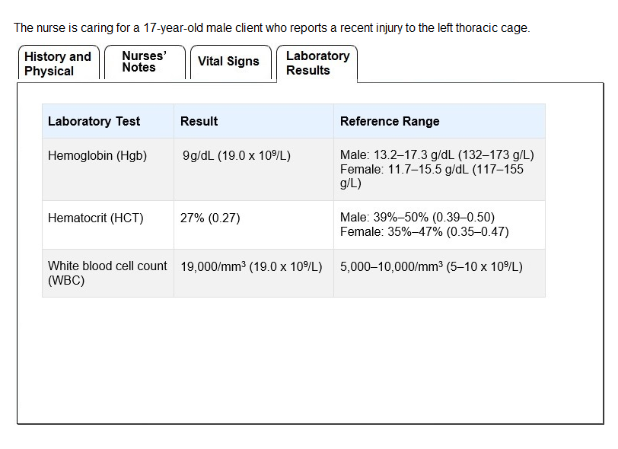

Slide 19
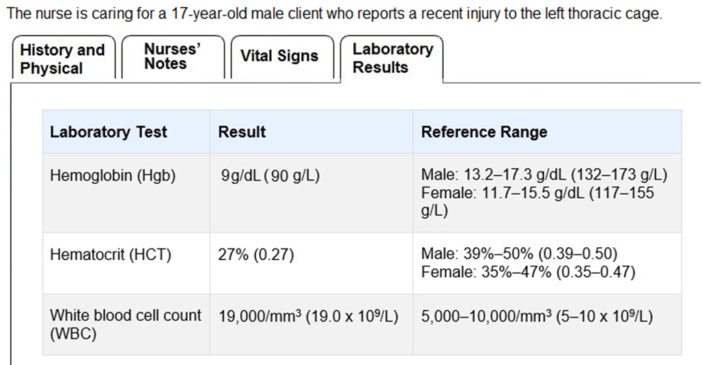

Slide 20
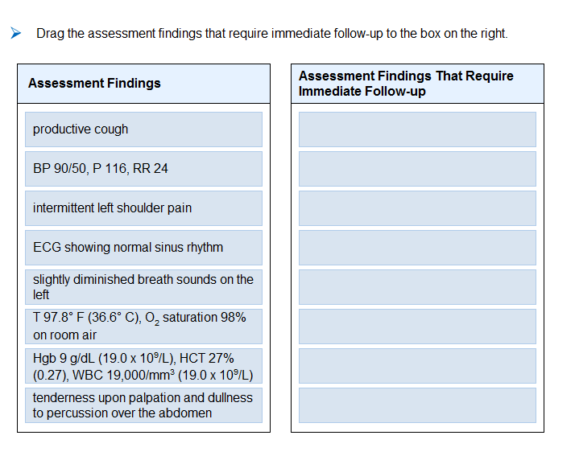
Extended Multiple Response

Slide 21


Slide 22
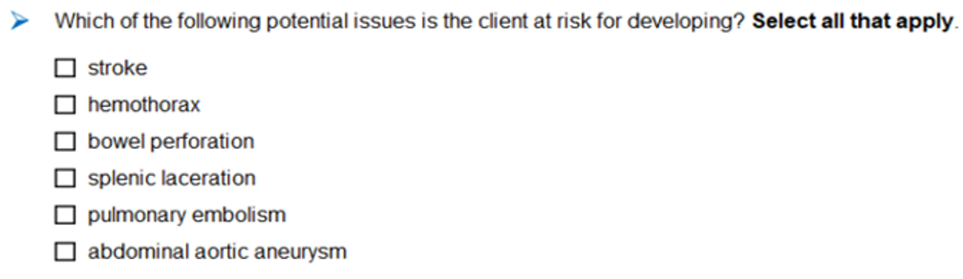
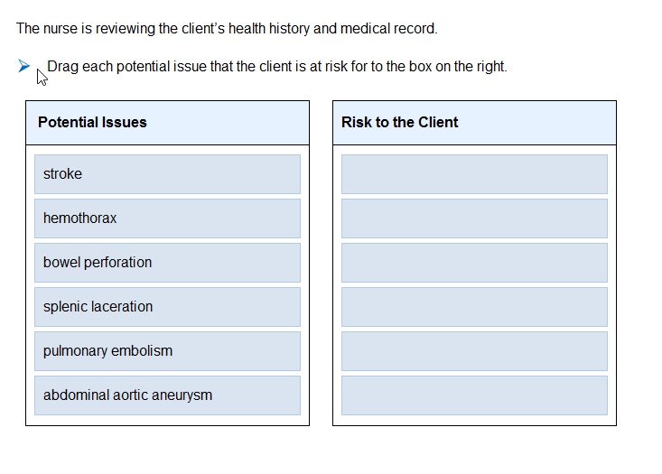
Extended Multiple Response

Slide 23


Slide 24
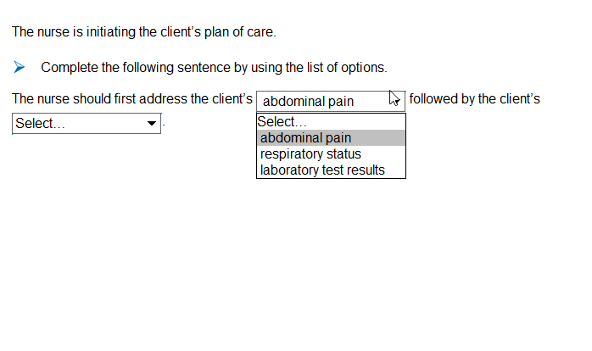
Cloze (Pull-Down Menu)

Slide 25


Slide 26
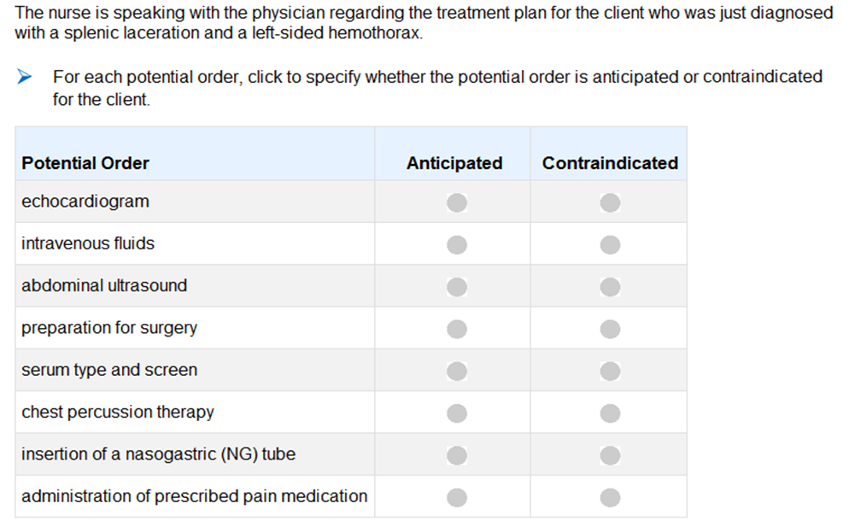
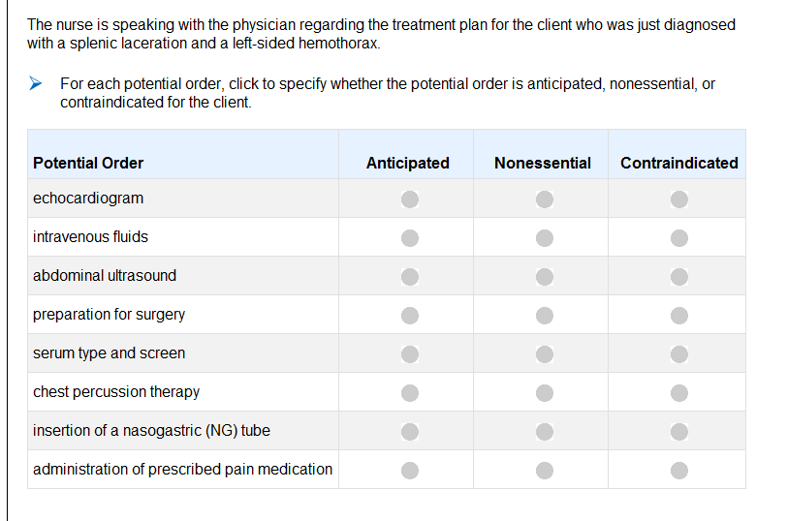
Matrix (Grid)

Slide 27


Slide 28
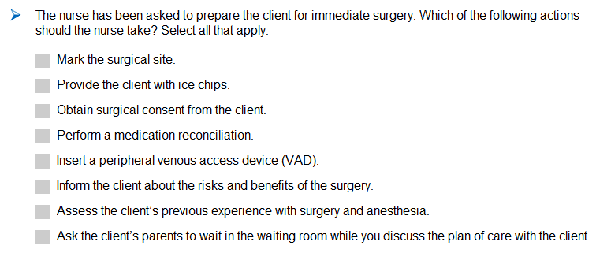
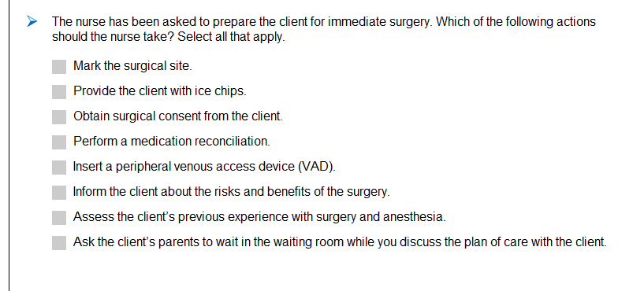
Extended Multiple Response

Slide 29


Slide 30
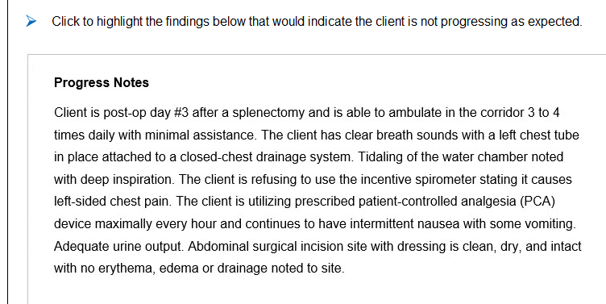
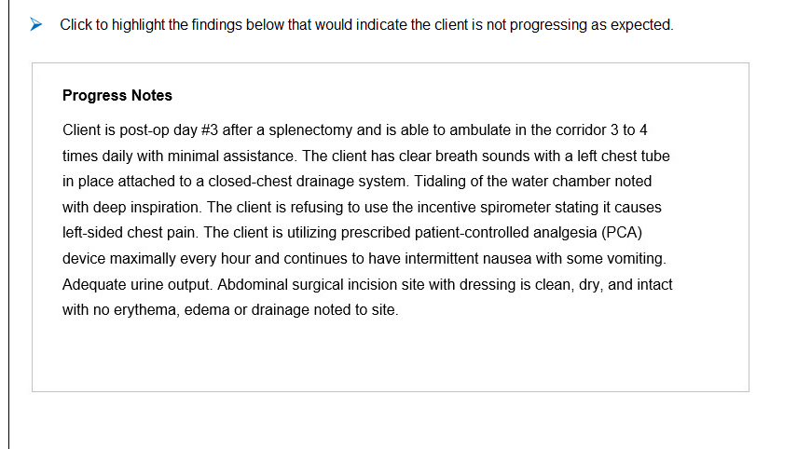
Highlighting

Slide 31


Slide 32
Case Study – Key Features
Focus on clinical judgment (“six boxes”)
Use of new item types
Real-world

Slide 33


Slide 34
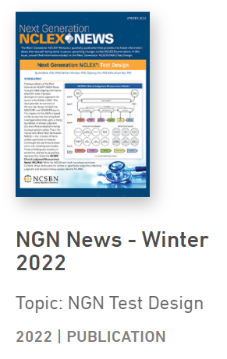
Test Design

Slide 35
NGN Test Design
How many questions are on the test?
How long will candidates have to take the test?
How many case studies will there be?
How many NGN standalone items will there be?
Will computer adaptive testing still be used?
Etc.
How different is the NGN from NCLEX?

Slide 36
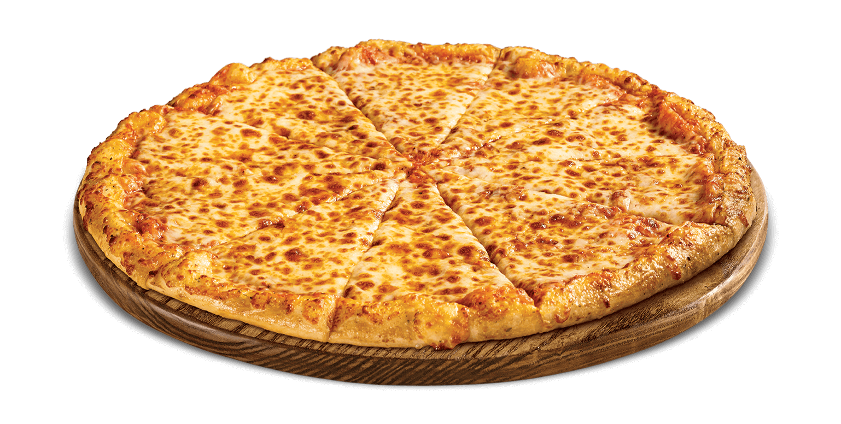

How different is the NGN from NCLEX?
Images licensed by Creative Commons

Slide 37
Approved NGN Test Design
Design Specification | NCLEX Today | Next Generation NCLEX (NGN)
Time Allowed | 5 hours | 5 hours
Delivery method | Variable-length CAT | Variable-length CAT *
Total Items (min – max) | 75 – 145 | 85 – 150
Total Scored Items (min – max) | 60 – 130 | 70 – 135
Case Studies | N/A | 3 (18 items)
Standalone items (traditional NCLEX + bowtie + trend, etc.) | 60 – 130** | 52 – 117**
Unscored (Pretest) Items | 15 | 15
* Items within a Case Study are static, not adaptive
** Range possible due to variable length CAT
Notes:
Review table
All but last two rows summarize what’s already been shown
OPTIONAL - Can indicate that time (5 hours) applies only to candidates without special testing time accommodations
CAT – Note that the CAT algorithm pauses during a case study. Candidates simply receive full case study rather than have items change dynamically depending on responses/ability estimates. (“CAT nap.” ☺)

Slide 38
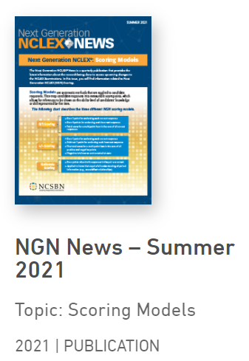
Scoring

Slide 39
A new approach to scoring
NCLEX today – A candidate response to an item is either correct or incorrect
  Points possible: 0 or 1
Next Generation NCLEX - A candidate response may be partially correct and receive partial credit
  Points possible: 0, 1, 2, 3, etc.

Slide 40
NCSBN NGN Resources

Slide 41
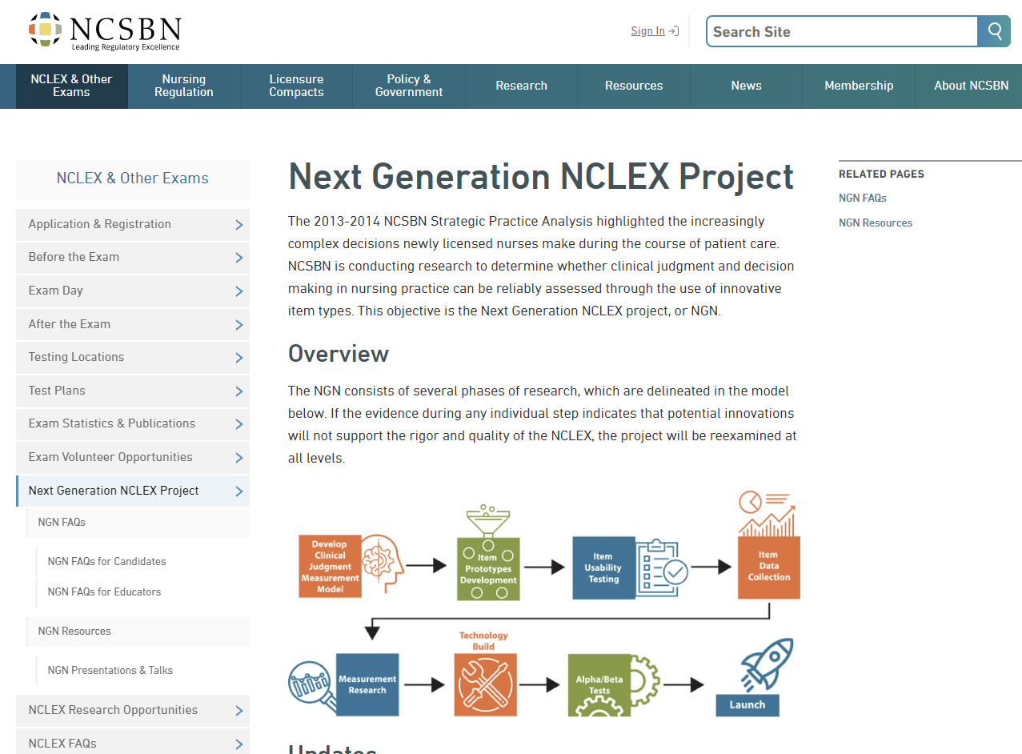
NGN Information on NCSBN Website

Slide 42

NGN Newsletters

Slide 43
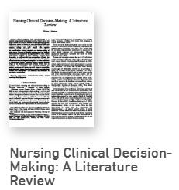
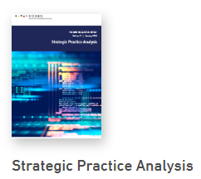


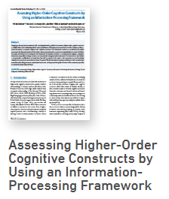
Webinars and Research

Slide 44
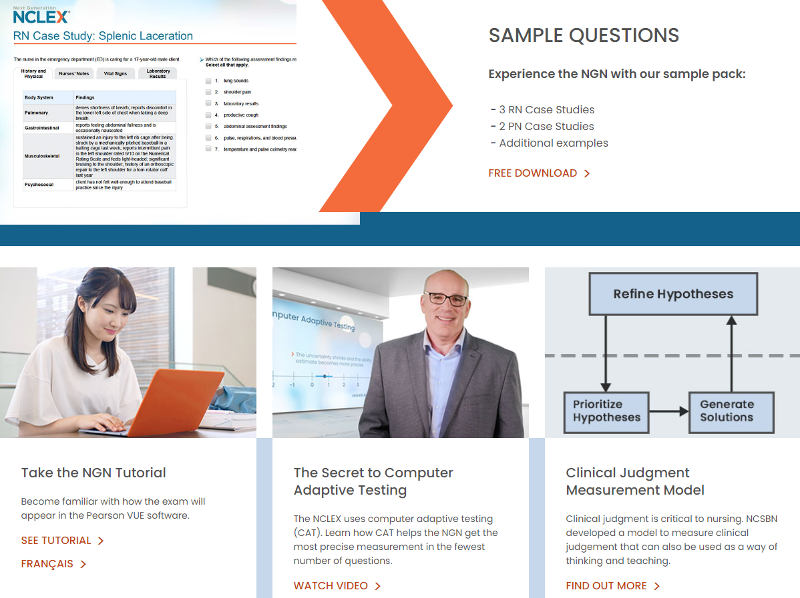
NextGenNurses.org

Slide 45


Slide 46

On the web at icrsncsbn.org

Slide 47
Questions

